Slide 1
Chapter 11:
Data and Database Administration
Modern Database Management
10^{h} Edition
Jeffrey A. Hoffer, V. Ramesh,
Heikki Topi
© 2011 Pearson Education, Inc. Publishing as Prentice Hall

Slide 2
Objectives
Define terms
List functions and roles of data/database administration
Describe role of data dictionaries and information repositories
Compare optimistic and pessimistic concurrency control
Describe problems and techniques for data security
Understand role of databases in Sarbanes-Oxley compliance
Describe problems and facilities for data recovery
Describe database tuning issues and list areas where changes can be done to tune the database
Describe importance and measures of data availability

Slide 3
Traditional Administration Definitions
Data Administration: A high-level function that is responsible for the overall management of data resources in an organization, including maintaining corporate-wide definitions and standards
Database Administration: A technical function that is responsible for physical database design and for dealing with technical issues such as security enforcement, database performance, and backup and recovery
Notes:
DA => management of overall corporate data, and responsible for its definition and standards
Dba -> responsible for physical DB design, deals with database security, database performance, back up and recovery
Examples of DA task
Create standard naming conventions
Managing reporting needs
Example of DBA task:
grant permission to a user
Ensure database are being backed up
Optimizing a query that is slow
Configuring the affinity of database memory allocation
Creating appropriate data and index files

Slide 4
Traditional Data Administration Functions
Data policies, procedures, standards
Planning
Data conflict (ownership) resolution
Managing the information repository
Internal marketing of DA concepts
Notes:
Data policies, procedures, standards -> documentation
Planning -> creating a roadmap
Data conflict (ownership) resolution
Managing the information repository
Internal marketing of DA concepts -> Data Governance

Slide 5
Traditional Database Administration Functions
Analyzing and designing databases
Selection of DBMS and software tools
Installing/upgrading DBMS
Tuning database performance
Improving query processing performance
Managing data security, privacy, and integrity
Data backup and recovery
Notes:
Analyzing and designing databases -> how are tables stored, how are indices stored? Data partitioned?
Selection of DBMS and software tools -> Monitoring tools, Replication Tools, Database selection
Installing/upgrading DBMS -> initial installation and periodic update
Tuning database performance -> the overall database to improve throughput
Improving query processing performance – looking at the query and find ways to make it run faster
Managing data security, privacy, and integrity -> permissions
Data backup and recovery -> backup locally and backup to a DR site

Slide 6
Data Warehouse Administration
New role, coming with the growth in data warehouses
Similar to DA/DBA roles
Emphasis on integration and coordination of metadata/data across many data sources
Specific roles:
  Support DSS applications
  Manage data warehouse growth
  Establish service level agreements regarding data warehouses and data marts
Notes:
Some DBAs manages both operational systems and DW. Bigger companies have dedicated DW Admin.s
Emphasis is to coordination of the data that comes from many data sources.
Managing growth of the DW -> bigger than operational systems
SLAs that company needs to meet. In terms of reporting requiements

Slide 7
Open Source DBMSs
An alternative to proprietary packages such as Oracle, Microsoft SQL Server, or Microsoft Access
MariaDB (fomer mySQL) is an example of an open-source DBMS
Less expensive than proprietary packages
Source code available, for modification
Absence of complete documentation
Not as feature-rich as proprietary DBMSs
Vendors may not have certification programs
Notes:
An alternative to proprietary packages such as Oracle and SQL Sever, are the open source systems
Some of you are using MySQL which used to be open source, but now owned by Oracle. The source code for MySQL is now called Maria DB
Less expensive than proprietary packages -> free or almost free
Source code available, for modification
Absence of complete documentation -> not as documented as proprietary packages
Ambiguous licensing concerns
Not as feature-rich as proprietary DBMSs
Vendors may not have certification programs

Slide 8
Database Security
Database Security: Protection of the data against accidental or intentional loss, destruction, or misuse
Increased difficulty due to Internet access and client/server technologies
Notes:
Another important database administration is Data security:
It goes hand in hand with cyber security.
Rich source for hackers trying to steal data
Database Security: Protection of the data against accidental or intentional loss, destruction, or misuse

Slide 9
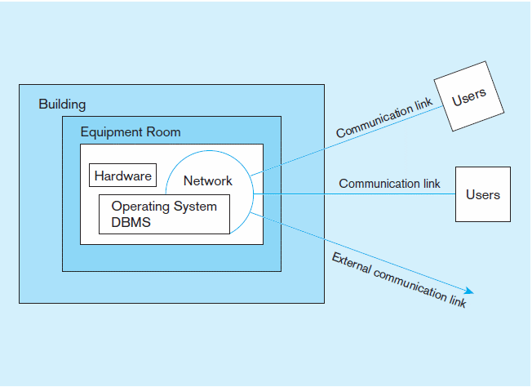
Figure 11-2 Possible locations of data security threats
Notes:
Most data theft happens within an organizations by people who work in the organization.
Building needs to be protected -> badge or other types of access cards to get into the building. Some companies have a security officer overseeing this.
Equipment room. Where are you switches , hubs and network equipment. Is there are data center in the building
Hardware -> how secure is you hardware
Operating system -> is it secure

Slide 10
Threats to Data Security
Accidental losses attributable to:
  Human error
  Software failure
  Hardware failure
Theft and fraud
Loss of privacy or confidentiality
  Loss of privacy (personal data)
  Loss of confidentiality (corporate data)
Loss of data integrity
Loss of availability (through, e.g. sabotage)
Notes:
Accidental losses attributable to:
Human error -> a mistake by a DBA to truncate or delete a table
Software failure -> a bug in a system that compromise the integrity of the data
Hardware failure -> disk or memory failure causing data destruction
Theft and fraud -> employees stealing confidential informations
Loss of privacy or confidentiality
Loss of privacy (personal data)
Loss of confidentiality (corporate data)
Loss of data integrity
Loss of availability (through, e.g. sabotage) -> system not responding through Denial of Service attach

Slide 11
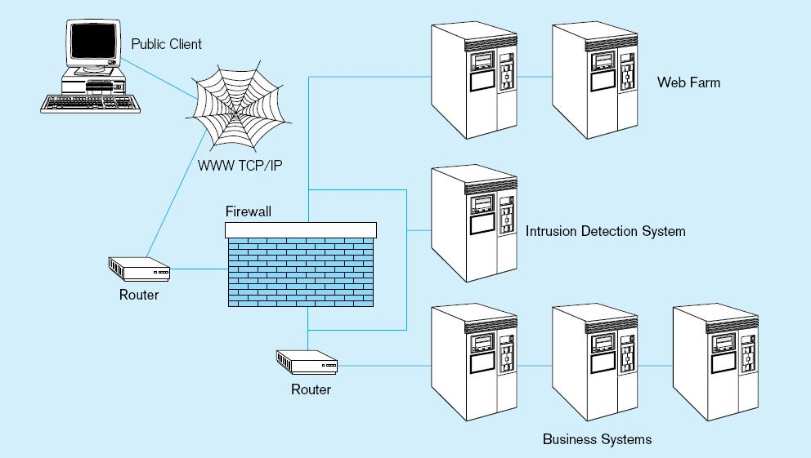
Figure 11-3 Establishing Internet Security
Notes:
There is typically a front end firewall protecting the internet from the internal applications.
Some companies create a DMZ zone housing all of the applications that are internet facing, and the database is behind another layer
Of firewall

Slide 12
Web Security
Static HTML files are easy to secure
  Standard database access controls
  Place Web files in protected directories on server
Dynamic pages are harder
  User authentication
  Session security
  SSL for encryption
  Restrict number of users and open ports
  Remove unnecessary programs
Notes:
Static files typically aren’t the problem since they don’t connect to any db source
Dynamic pages are bigger problem:
User authentication -> needs privileges to connect to a db back end
Session security -> security is handled via a session or a cookie
SSL for encryption -> secure socket layer to encrypt the data. TLS 1.2 is the new standard
Restrict number of users and open ports -> SQL server listens on 1433, change the port
Remove unnecessary programs -> only have programs in the DMZ that you need

Slide 13
Database Software Security Features
Views or subschemas
Integrity controls
Authorization rules
User-defined procedures
Encryption
Authentication schemes
Backup, journalizing, and checkpointing
Notes:
At the database level, a rule of thumb is to provide the least privilege possible.
Views or subschemas -> never provide access to the entire db
Authorization rules - who is authorized to see what. Can they DELETE, INSERT or read only
User-defined procedures -> who has access to execute procedures
Encryption -> what data should be encrypted, what type of encryption
Authentication schemes -> who should be allowed in the datbase
Backup, journalizing, and checkpointing

Slide 14
Views and Integrity Controls
Views
  Subset of the database that is presented to one or more users
  User can be given access privilege to view without allowing access privilege to underlying tables
Integrity Controls
  Protect data from unauthorized use
  Domains–set allowable values
  Assertions–enforce database conditions
  Triggers – prevent inappropriate actions, invoke special handling procedures, write to log files
Notes:
Views
Only a subset of fields are presented to the users
Privileges without granting accces to the underlying tables
Integrity Controls
Protect the data from un-authorized use
Domains – which values are allowed
Triggers – create special handling

Slide 15
Authorization Rules
Controls incorporated in the data management system
➔Restrict:
  access to data
  actions that people can take on data
➔Authorization matrix for:
  Subjects
  Objects
  Actions
  Constraints
Notes:
Difference between authorization and authentication.
Authentication -> who is allowed to have access.
➔Authorization matrix for:
Subjects -> users that are in Finance can only perform action related to Finance
Objects -> which tables or sp are they have access to
Actions -> insert, update, delete
Constraints

Slide 16
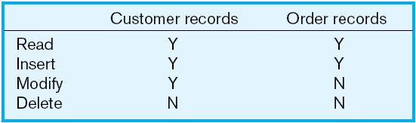
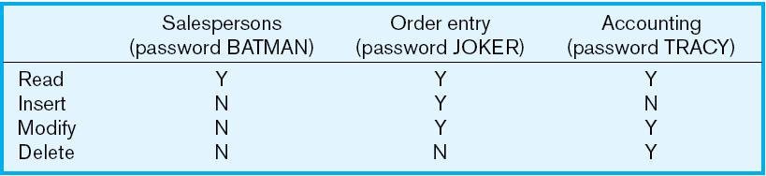
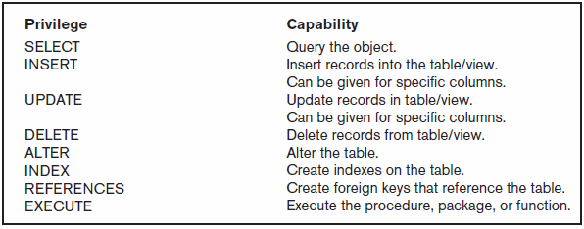
Figure 11-5a Authorization table for subjects (salespersons)
Implementing authorization rules
Figure 11-5b Authorization table for objects (orders)
Figure 11-6 Oracle privileges
Some DBMSs also provide capabilities for user-defined procedures to customize the authorization process
Notes:
Example of authorization by subject salesperson
Example of authorization by objects orders
Having these matrices enables authorization to be limited to only what is needed.

Slide 17
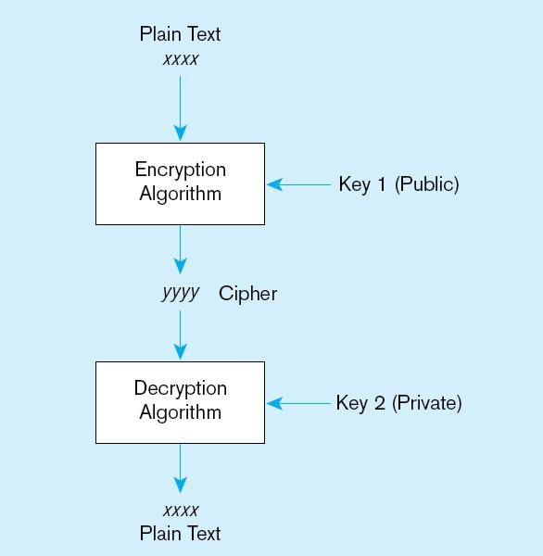
Figure 11-7 Basic two-key encryption
Encryption – the coding or scrambling of data so that humans cannot read them
Secure Sockets Layer (SSL) is a popular encryption scheme for TCP/IP connections
Notes:
Some fields with sensitive data needs to be encrypted . SS Number, Credit Card Number
In this example, a basic two key encryption… Also know as private/public key
A user encryptis with the public key, and decrypted with a private key

Slide 18
Authentication Schemes
Goal – obtain a positive identification of the user
Passwords: First line of defense
  Should be at least 8 characters long
  Should combine alphabetic and numeric data
  Should not be complete words or personal information
  Should be changed frequently
Notes:
Authentication, which is a way to identify the user.
The most common form is password.

Slide 19
Authentication Schemes (cont.)
Strong Authentication
  Passwords are flawed:
    Users share them with each other
    They get written down, could be copied
    Automatic logon scripts remove need to explicitly type them in
    Unencrypted passwords travel the Internet
Possible solutions:
  Two factor–e.g. smart card plus PIN
  Three factor–e.g. smart card, biometric, PIN
Notes:
Strong Authentication
decent length and combination of characters. Passwords are flawed: copy down, shared, uncrypted could be captured
Possible solutions:
Two factor–e.g. smart card plus PIN
Three factor–e.g. smart card, biometric, PIN

Slide 20
Sarbanes-Oxley (SOX)
Requires companies to audit the access to sensitive data
Designed to ensure integrity of public companies’ financial statements
SOX audit involves:
  IT change management
  Logical access to data
  IT operations
Notes:
The U.S. Congress passed the Sarbanes-Oxley Act of 2002 to help protect investors from fraudulent financial reporting by corporations.

Slide 21
IT Change Management
The process by which changes to operational systems and databases are authorized
For database, changes to: schema, database configuration, updates to DBMS software
Segregation of duties: development, test, production
Notes:
The process by which changes to operational systems and databases are authorized
For database, changes to: schema, database configuration, updates to DBMS software
Segregation of duties: development, test, production

Slide 22
Logical Access to Data
Personnel controls
  Hiring practices, employee monitoring, security training, separation of duties
Physical access controls
    Swipe cards, equipment locking, check-out procedures, screen placement, laptop protection
Notes:
Personnel controls :security training separation of duties
Physical access controls: through laptops, through data center

Slide 23
IT Operations
Policies and procedures for day-to-day management of infrastructure, applications, and databases in an organization
For databases: backup, recovery, availability
Notes:
For databases: backup, recovery, availability

Slide 24
Database Recovery
Mechanism for restoring a database quickly and accurately after loss or damage
Recovery facilities:
  Backup Facilities
  Journalizing Facilities
  Checkpoint Facility
  Recovery Manager

Slide 25
Back-up Facilities
DBMS copy utility that produces backup copy of the entire database or subset
Periodic backup (e.g. nightly, weekly)
Cold backup–database is shut down during backup
Hot backup–selected portion is shut down and backed up at a given time
Backups stored in secure, off-site location
Notes:
Backups need to go to DR site

Slide 26
Journalizing Facilities
Audit trail of transactions and database updates
Transaction log–record of essential data for each transaction processed against the database
Database change log–images of updated data
  Before-image–copy before modification
  After-image–copy after modification
Produces an audit trail
Notes:
In addition to the journalizing facilities.
There is a need to design the data model to capture the change

Slide 27
Recovery and Restart Procedures
Disk Mirroring–switch between identical copies of databases
Restore/Rerun–reprocess transactions against the backup
Transaction Integrity–commit or abort all transaction changes
Backward Recovery (Rollback)–apply before images
Forward Recovery (Roll Forward)–apply after images (preferable to restore/rerun)
Notes:
Disk Mirroring–switch between identical copies of databases. High Availability
Restore/Rerun–reprocess transactions against the backup.
Transaction Integrity–commit or abort all transaction changes
Backward Recovery (Rollback)–apply before images
Forward Recovery (Roll Forward)–apply after images (preferable to restore/rerun

Slide 28
Transaction ACID Properties
Atomic
  Transaction cannot be subdivided
Consistent
  Constraints don’t change from before transaction to after transaction
Isolated
  Database changes not revealed to users until after transaction has completed
Durable
  Database changes are permanent

Slide 29
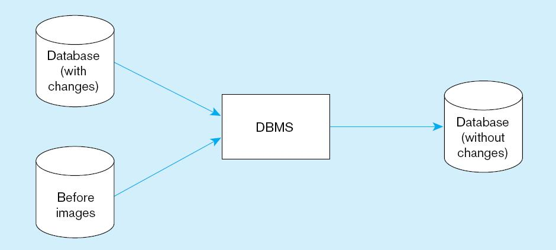
Figure 11-9 Basic recovery techniques
a) Rollback
Notes:
Rollback procedures

Slide 30
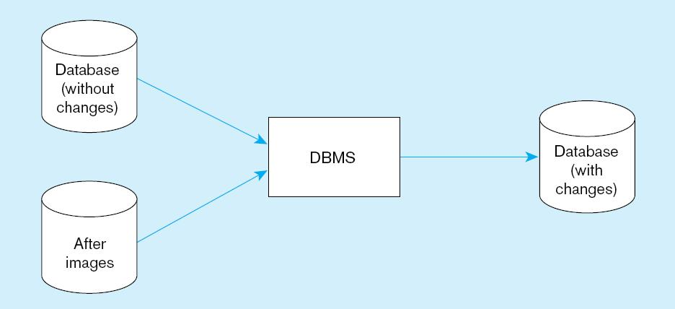
Figure 11-9 Basic recovery techniques (cont.)
b) Rollforward
Notes:
Rollfoward procedures

Slide 31
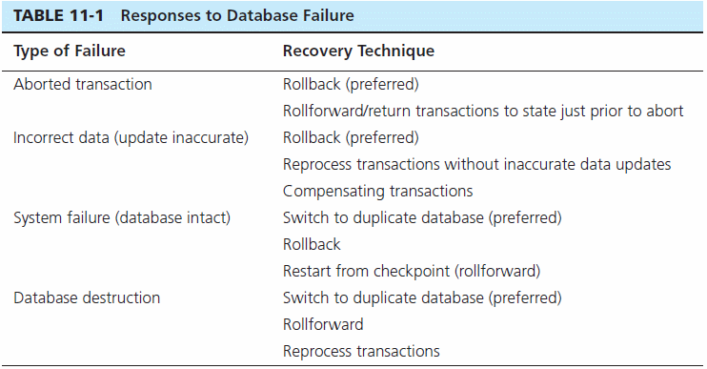

Slide 32
Concurrency Control
Problem–in a multi-user environment, simultaneous access to data can result in interference and data loss
Solution–Concurrency Control
  The process of managing simultaneous operations against a database so that data integrity is maintained and the operations do not interfere with each other in a multi-user environment

Slide 33
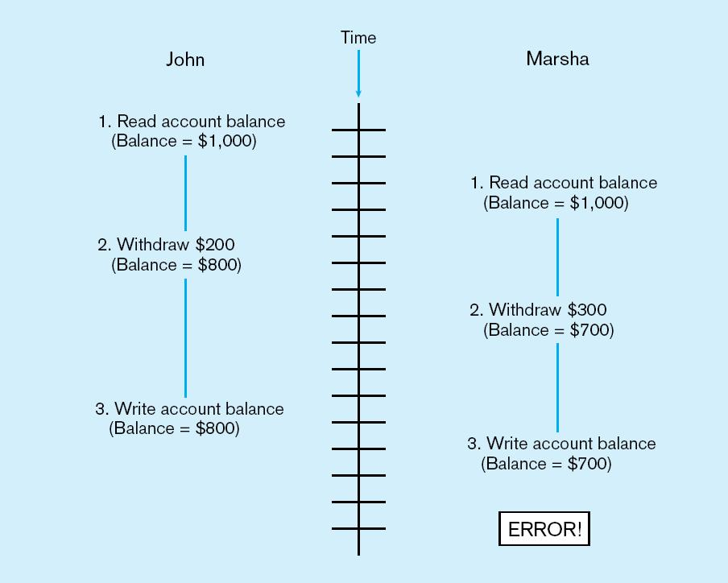
Figure 11-10 Lost update (no concurrency control in effect)
Simultaneous access causes updates to cancel each other
A similar problem is the inconsistent read problem

Slide 34
Concurrency Control Techniques
Serializability
  Finish one transaction before starting another
Locking Mechanisms
  The most common way of achieving serialization
  Data that is retrieved for the purpose of updating is locked for the updater
  No other user can perform update until unlocked

Slide 35
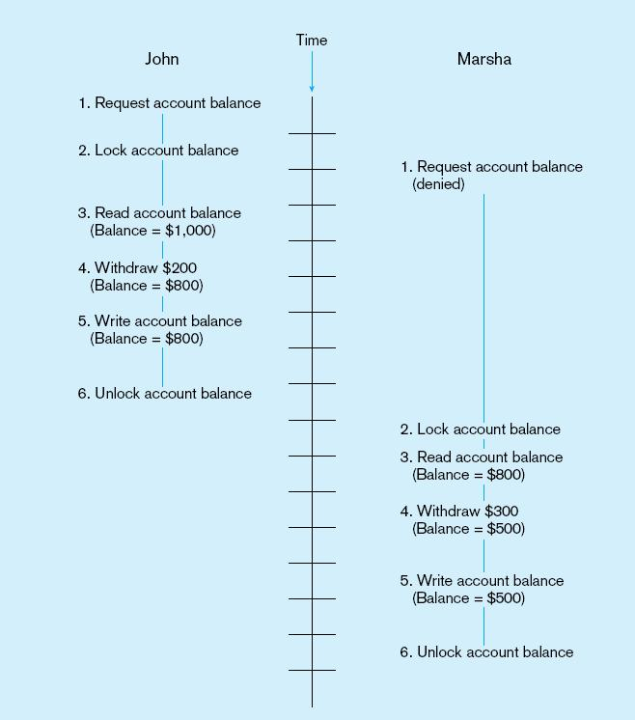
Figure 11-11: Updates with locking (concurrency control)
This prevents the lost update problem

Slide 36
Locking Mechanisms
Locking level:
  Database–used during database updates
  Table–used for bulk updates
  Block or page–very commonly used
  Record–only requested row; fairly commonly used
  Field–requires significant overhead; impractical
Types of locks:
  Shared lock–Read but no update permitted. Used when just reading to prevent another user from placing an exclusive lock on the record
  Exclusive lock–No access permitted. Used when preparing to update
Notes:
Locking granularity
Types of locks. Modes

Slide 37
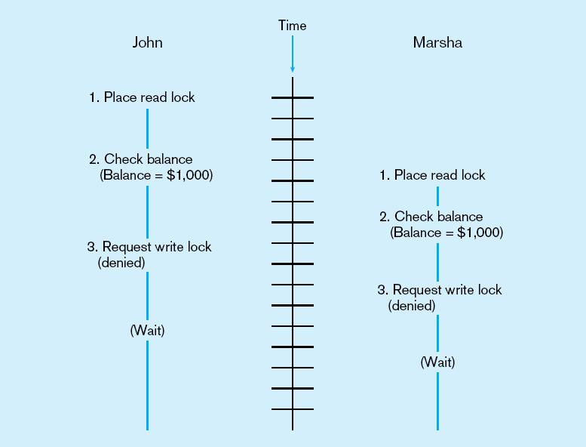
Deadlock
An impasse that results when two or more transactions have locked common resources, and each waits for the other to unlock their resources
Figure 11-12
The problem of deadlock
John and Marsha will wait forever for each other to release their locked resources!

Slide 38
Versioning
Optimistic approach to concurrency control
Instead of locking
Assumption is that simultaneous updates will be infrequent
Each transaction can attempt an update as it wishes
The system will reject an update when it senses a conflict
Use of rollback and commit for this

Slide 39
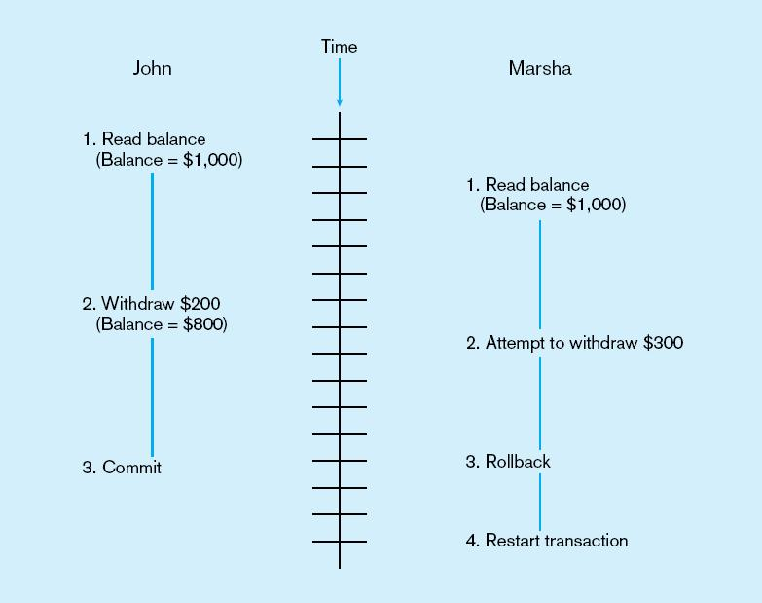
Figure 11-14 The use of versioning
Better performance than locking
Notes:
With row versioning, and optimistic model, checking of locks is delayed until the end

Slide 40
Database Performance Tuning
DBMS Installation
  Setting installation parameters
Memory and Storage Space Usage
  Set cache levels
  Choose background processes
  Data archiving
Input/output (I/O) Contention
  Use striping
  Distribution of heavily accessed files
CPU Usage – Monitor CPU load
Application tuning
  Modification of SQL code in applications
  Use of heartbeat queries
Notes:
DBMS Installation - Setting parameters right the first time
Memory and Storage Space Usage -Set cache levels, archive older data sets
Input/output (I/O) Contention
Stripping is spreading segments of I/O into multiple devices
Striping is used across disk drives in redundant array of independent disks (RAID) storage
CPU Usage – Monitor CPU load
Application tuning
Modification of SQL code in applications
Use of heartbeat queries

Slide 41
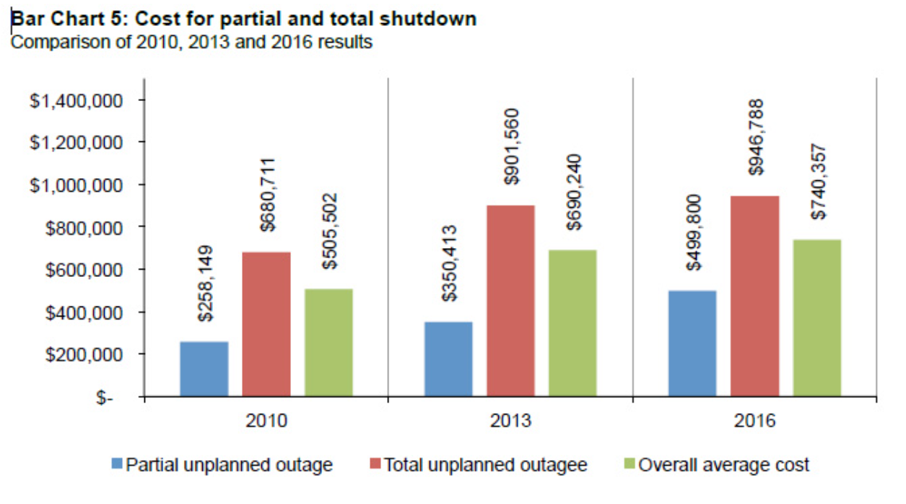
Cost of Downtime
Downtime is expensive
Notes:
Cost of downtime in 2016 was 740k. That’s $8,851 per minute of lost revenue, and unproductive employees

Slide 42
Data Availability
How to ensure availability
  Hardware failures–provide redundancy for fault tolerance
  Loss of data–database mirroring
  Human error–standard operating procedures, training, documentation
  Maintenance downtime–automated and non-disruptive maintenance utilities
  Network problems–careful traffic monitoring, firewalls, and routers
Notes:
Hardware - triple redundant
Loss of data – mirroring, replication, log shipping, Clustering

